Slide 1

Online shoppers purchasing intention analysis

Slide 2
25MT1306E – MATHEMATICS FOR DATA SCIENCE AND ANALYSTICS
2510030376
ANNAM CHANDANA
2510030217
ATAVALI SIRISHA
2510030145
INUGANTI NITEEKSHA

Slide 3
PROJECT REPORT on ONLINE SHOPPERS PURCHASING INTENTION ANALYSIS
Under the guidance of
Dr . Nagesh
Department of Mathematics
By
2510030376 – ANNAM CHANDANA
2510030217 – ATAVALI SIRISHA
2510030145 – INUGANTI NITEEKSHA
KONERU LAKSHMAIAH EDUCATION FOUNDATION
DEPARTMENT OF MATHEMATICS
Moinabad Road, Aziznagar , Hyderabad , 500075. June – 2026

Slide 4

Declaration By Student we hereby declare that the project report titled “Oline Shoppers Purchasing Intention Analysis” submitted in partial fulfillment of the requirements for the course Mathematics for Data Science and Analytics is a record of original work carried out by us under the guidance of Dr. Nagesh
Signature of the Students
1:
2:
3:
Certificate
This is to certify that the project titled“Online Shoppers Purchasing Intention Analysis” submitted by the students of B-Tech is a Bonafide work carried out under my guidance during the academic year 2025–2026.
The project satisfies the requirements for the course 25MT1306E – Mathematics for Data Science and Analytics.
Signature of the Guide

Slide 5
ABSTRACT
The project “Online Shoppers Purchasing Intention Analysis” focuses on analyzing customer behavior in online shopping platforms using data science and statistical techniques. The main objective of the project is to identify the factors influencing customer purchasing intention and predict whether a customer is likely to make a purchase.
The dataset used in this project contains information related to user sessions, browsing behavior, administrative pages visited, product-related pages, bounce rates, exit rates, page values, visitor types, and revenue outcomes. Data preprocessing techniques such as handling missing values, removing duplicates, and converting data types were performed to improve data quality.
Exploratory Data Analysis (EDA) was carried out using visualizations including bar charts, histograms, and correlation heatmaps to understand patterns and relationships among variables. Statistical inference and probability analysis were used to derive meaningful insights from the dataset.
Regression analysis was applied to build predictive models and evaluate performance using metrics such as R² Score, MAE, and RMSE. The project was implemented using Python libraries including Pandas, NumPy, Matplotlib, and Scikit-learn.
The results indicate that factors such as page value, visitor type, and browsing duration significantly affect purchasing intention. The project helps businesses improve marketing strategies and customer experience.

Slide 6
INTRODUCTION
Online shopping has become one of the fastest-growing sectors in the digital economy. E-commerce platforms generate large amounts of customer interaction data every day. Analyzing this data helps businesses understand customer behavior, improve product recommendations, and increase sales.
The rapid growth of internet usage and digital payment systems has encouraged customers to shop online frequently. However, predicting whether a visitor will complete a purchase remains a major challenge for online businesses. Understanding purchasing intention can help companies optimize advertisements, personalize recommendations, and improve customer satisfaction.
This project focuses on analyzing online shoppers’ purchasing intentions using data science and statistical techniques. The dataset contains customer browsing information such as page visits, session duration, bounce rates, exit rates, and visitor categories. By analyzing these features, it is possible to identify patterns associated with purchasing behavior.
The significance of this study lies in helping e-commerce companies improve conversion rates and customer retention. Businesses can use predictive analysis to target potential customers effectively and reduce marketing costs.
The main objectives of the project are:
To preprocess and clean the dataset
To perform exploratory data analysis
To apply statistical inference techniques
To develop a regression model for prediction
To interpret customer purchasing behavior
The dataset used in this project was obtained from an online shoppers purchasing intention dataset containing customer interaction records. Python programming language and tools such as Pandas, NumPy, Matplotlib, and Scikit-learn were used for implementation.
The expected outcome of the project is to identify important features influencing customer purchases and evaluate prediction accuracy using machine learning models.
The report is organized into methodology, analysis, results, conclusion, and references sections.

Slide 7
METHODLOGY
M1: DATA CLEANING
Data cleaning is an important step in data analysis .
import pandas as pd
# Load dataset
df = pd.read_csv('online_shoppers.csv')
# Display first 5 rows
df.head()
# Check missing values
print(df.isnull().sum())
# Remove duplicates
df.drop_duplicates(inplace=True)
Observation
Dataset loaded successfully
Missing values checked
Duplicate rows removed

Slide 8
M2: Exploratory Data Analysis (EDA) Dataset Information
# Basic dataset information
print(df.info())
# Statistical summary
print(df.describe())
Observation
Dataset contains numerical and categorical columns
Statistical summary helps understand data distribution

Slide 9
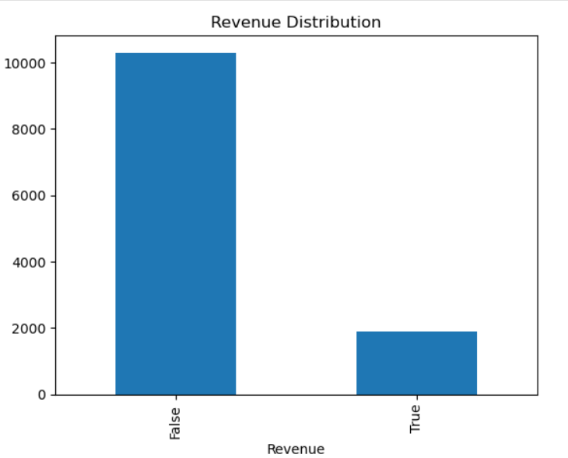
Revenue Distribution Graph
df['Revenue'].value_counts().plot(kind='bar’)
plt.title('Revenue Distribution’)
plt.show()
Observation
Majority of customers did not generate
revenue
Only a smaller portion completed
purchases

Slide 10
M5: Regression Analysis
from sklearn.model_selection import train_test_split # Predictions
from sklearn.linear_model import LinearRegression pred =model.predict(X_test)
from sklearn.metrics import r2_score print(‘R2 Score:’ , r2_score(y_test , pred))
# Select numerical columns
numeric_df = df.select_dtypes(include='number’)
# Features and target variable
X = numeric_df.iloc[:, :-1]
y = numeric_df.iloc[:, -1]
# Split dataset
X_train, X_test, y_train, y_test = train_test_split(
X, y, test_size=0.2, random_state=42
)
# Create model
model = LinearRegression()
# Train model
model.fit(X_train, y_train)
Observation
Linear Regression model was applied successfully
R² score measures prediction accuracy

